Slide 1

Go, change the world
RV College of
Engineering
Discrete Mathematics in Network Security Protocols

Slide 2

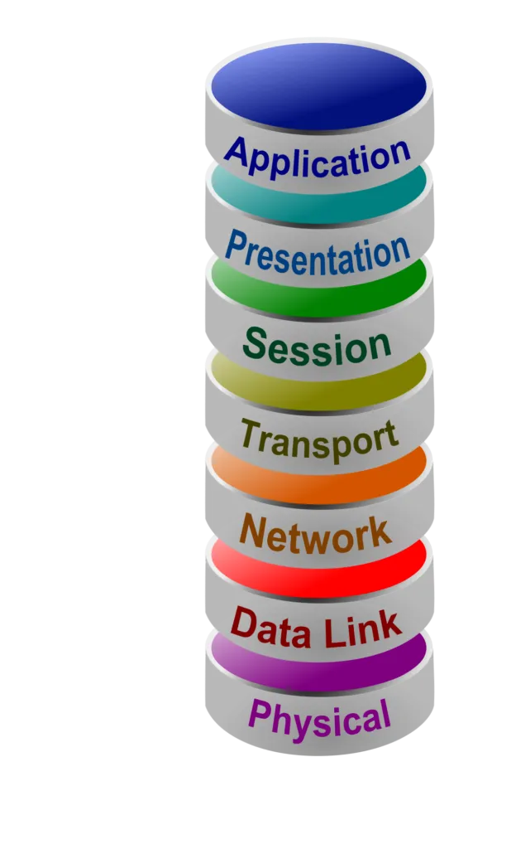


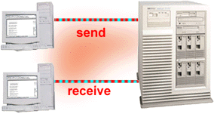
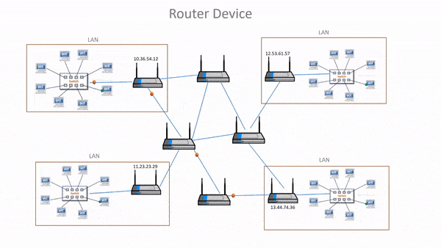
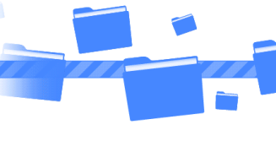
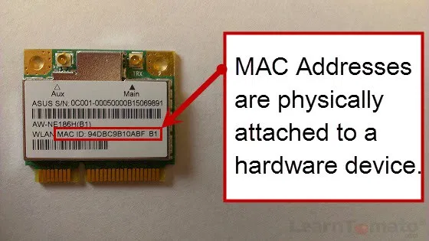

Go, change the world
RV College of
Engineering
BRIEF OVERVIEW - THE OSI MODEL

Slide 3
Go, change the world
RV College of
Engineering
ENCRYPTION INTRODUCTION
In today’s cyber-world, there is an ever-present risk of unauthorized access to all forms of data. Most at risk is financial and payment system data that can expose the personal identifying information (PII) or payment card details of customers and clients. Encryption is crucial for protecting PII and mitigating the risks that businesses which conduct payment transactions face every minute of every day.
ENCRYPTION is the process of converting a plain text (message) into a cipher (unreadable or scrambled) text using various mathematical formulae as algorithms.
Special rules or relations, called KEYS, indicate the relationship between the original and the encrypted texts. They are usually a string of numbers measured in bits.

Slide 4
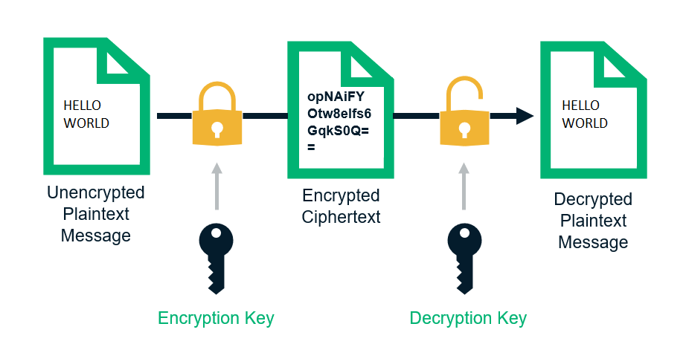
Go, change the world
RV College of
Engineering
HOW ENCRYPTION WORKS ?

Slide 5


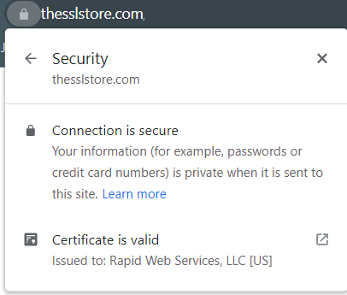


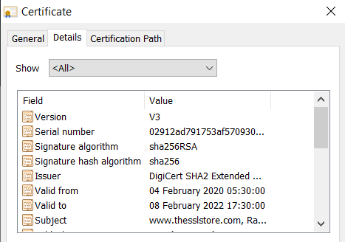


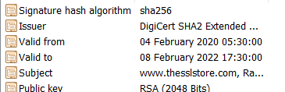

Go, change the world
RV College of
Engineering
HOW TLS WORKS: THE HANDSHAKE
CLIENT ‘HELLO’
(PUBLIC KEY)
SERVER ‘HELLO’
(CERTIFICATE + PUBLIC KEY)
CLIENT CREATES A PRE-MASTER SECRET USING THE SERVER’S PUBLIC KEY AND A SESSION KEY
SERVER DECRYPTS THE TEXT TO GET THE SESSION KEY USING ITS PRIVATE KEY
SERVER SENDS AN ACK USING THE SYMMETRIC KEY
NOW, BOTH SERVER AND CLIENT COMMUNICATE USING THE SYMMETRIC KEY ONLY

Slide 6
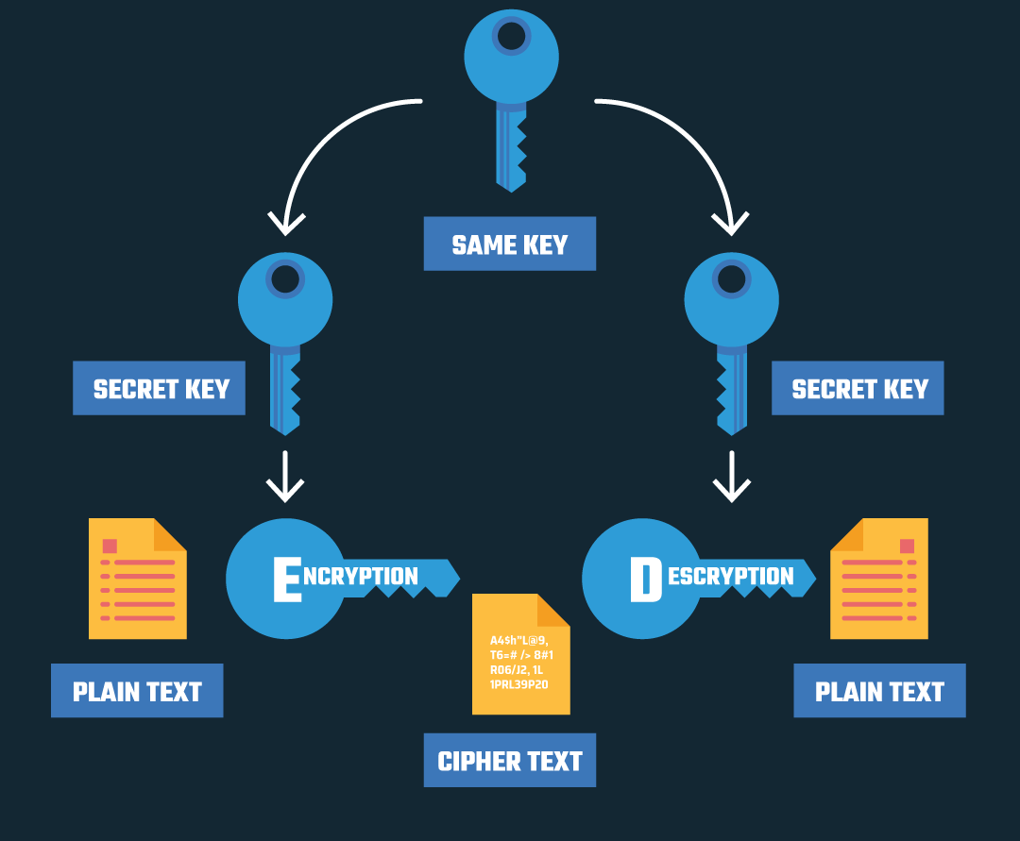
Go, change the world
RV College of
Engineering
SYMMETRIC ENCRYPTION
In symmetric encryption, there is only one key, and all parties involved use the same key to encrypt and decrypt information.
Drawback: The connection isn’t secure when the shared key is exchanged. Hence, any third party on the network could grab the shred key and listen to the encrypted message.

Slide 7
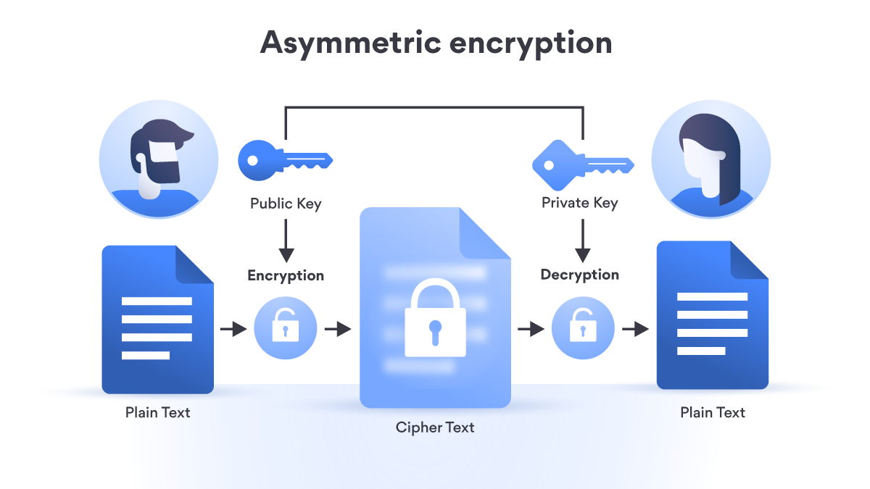
Go, change the world
RV College of
Engineering
ASYMMETRIC ENCRYPTION
In Asymmetric encryption, one key is made public so that anyone who wants to send the receiver any data, could use it for encryption, while the second key is kept private as the receiver will use it for decryption.
It ensures that one sender wouldn’t be able to read the messages sent by another sender, even though they both have the receiver’s public key.
It’s also close to impossible to find out which private key belongs to which public key.
Drawbacks: It takes more computing resources and time to encrypt and decrypt information.
Its keys have to be longer to provide the same level of security that symmetric encryption does.

Slide 8
Go, change the world
RV College of
Engineering
ENCRYPTION ALGORITHMS
ENCRYPTION
ALGORITHMS
SYMMETRIC ENCRYPTION ALGORITHMS
ASYMMETRIC ENCRYPTION ALGORITHMS
DES
AES
RSA
DIFFIE - HELLMAN

Slide 9
Go, change the world
RV College of
Engineering
PROBLEM STATEMENT
PROBLEM STATEMENT
Transfer of information and data over internet is vulnerable to various security threats and unauthorized access. Transmission of confidential and sensitive information among different networks is possible without compromise due to data encryption.
OBJECTIVES
To implement AES, RSA and Diffie Hellman encryption algorithms.
To understand the use of discrete mathematical concepts such as Modular Arithmetic and Group theory in network protocols.
REQUIREMENTS
C++ compiler
MATLAB

Slide 10
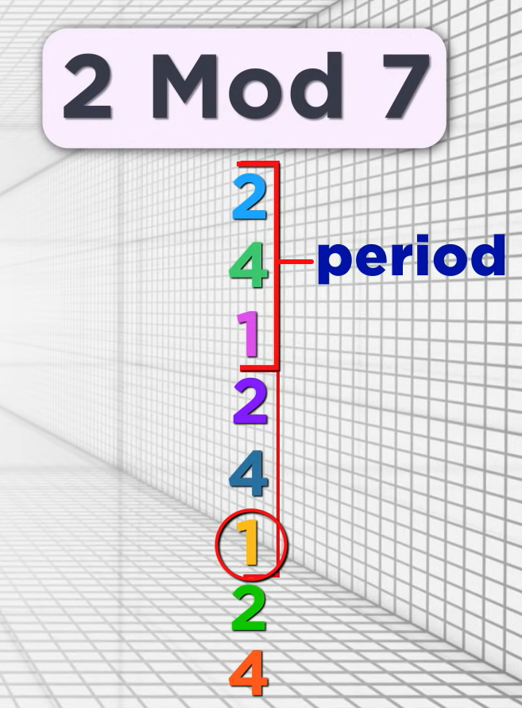
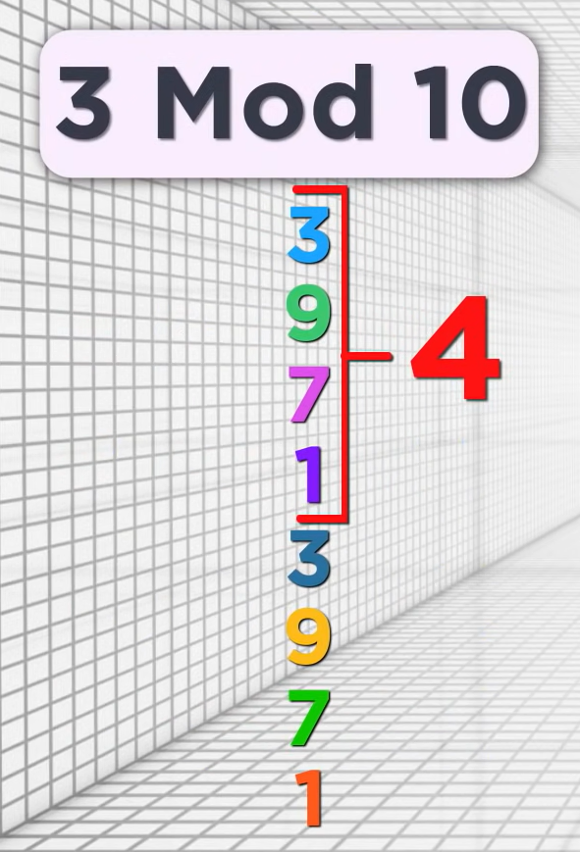
Go, change the world
RV College of
Engineering
MODULAR ARITHMETIC
Modular arithmetic is the system of arithmetic for integers which involves expressing numbers in terms of their remainders.
For a positive integer n, the integers a and b are congruent mod n if their remainder when divided by n are the same
Example: 52≡24(mod7) (The remainder when 52 (=7x7+3) is divided by 7 is the same as 24 (=3x7+3))
For 2 coprime numbers x and N, x, x^2, x^3,.. Each mod N follows a repeating pattern where the pattern ends with 1.
As we see, the patterns end with 1. The number of repeating elements is called period of 1 mod N.
The last number of the pattern is represented as:
3^4 ≡ 1 mod 10
(or)
Period of 3 Mod 10 is 4

Slide 11
Go, change the world
RV College of
Engineering
MODULAR ARITHMETIC
Modular arithmetic is the system of arithmetic for integers which involves expressing numbers in terms of their remainders.
Congruence Modulo
For a positive integer n, the integers a and b are congruent mod n if their remainder when divided by n are the
same.
a ≡ b(mod n) can also be written as
· a mod n = b mod n
· n | (a-b) (n divides a -b)
· a = k.n + b
Congruence modulo is an equivalence relation
· a≡a (mod n) (Reflexive)
· If a≡b (mod n) then b≡a (mod n) (Symmetric)
· If a≡b (mod n) and If b≡d (mod n) then a≡d(mod n) (Transitive)
If A/B = Q remainder R then, R = A mod B
If a/n = q1 remainder r and b/n = q2 remainder r then, a ≡ b(mod n)
For 2 coprime numbers x and N, x, x^2, x^3,.. Each mod N follows a repeating pattern where the pattern ends with 1.The number of repeating elements is called period of 1 mod N.
The last number of the pattern is represented as:
3^4 ≡ 1 mod 10
(or)
Period of 3 Mod 10 is 4

Slide 12
Go, change the world
RV College of
Engineering
MODULAR ARITHMETIC
Modulo operations
Modular addition: (A + B) mod C = (A mod C + B mod C) mod C
Modular subtraction: (A - B) mod C = (A mod C - B mod C) mod C
Modular multiplication: (A * B) mod C = (A mod C * B mod C) mod C
Modular exponentiation: A^B mod C = ( (A mod C)^B ) mod C
Modular inverse
In modular arithmetic we do not have a division operation. However, we do have modular inverses.
· The modular inverse of A (mod C) is A^-1
· (A * A^-1) ≡ 1 (mod C) or equivalently (A * A^-1) mod C = 1
· Only the numbers coprime to C (numbers that share no prime factors with C) have a modular inverse (mod C)

Slide 13
Go, change the world
RV College of
Engineering
EULER’S THEOREM
Fermat’s Little theorem: If p is a prime number, then for any integer a, the number a ^{p} – a is an integer multiple of p.
Euler’s totient function: Euler’s Totient function Φ (n) for an input n is the count of numbers in {1, 2, 3, …, n} that are relatively prime to n
Properties of Euler’s Totient function
· For a prime number p, Φ (p) = p-1
· For 2 prime numbers a and b Φ (a.b) = Φ (a). Φ (b) = (a-1)(b-1)
Euler’s theorem states that if n and a are coprime (or relatively prime) positive integers, then a^{Φ(n)} ≡ 1 (mod n)
a^{p-1} ≡ 1 (mod p)
a^{Φ(n)} ≡ 1 (mod n)

Slide 14
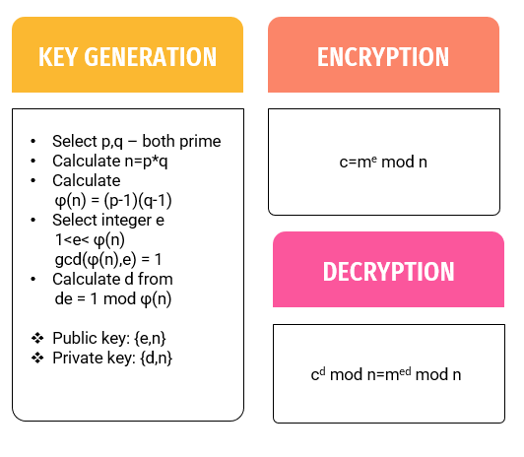
Go, change the world
RV College of
Engineering
RSA ALGORITHM
RSA (Rivest–Shamir–Adleman) is an algorithm used by modern computers to encrypt and decrypt messages. It is an asymmetric cryptographic algorithm. RSA is used for purposes when any sender can encrypt a message using the public key but only the receiver can decrypt it with the private key in their possession.
Diﬃe Hellman key exchange protocol establishes a secret shared key between two parties while RSA protocol provides direct encryption and security of messages.
It has 3 main steps key generation, encryption and decryption and it involves the following concepts

Slide 15
Go, change the world
RV College of
Engineering
RSA ALGORITHM
Step 1: Bob starts with two large prime numbers p and q. He computes their product
n=pq and another product φ(n) = (p-1)(q-1).
Step 2: Now he chooses a coprime e with respect to φ(n) and announces e and n publicly.
So {n, e} is the public key which will be used for encryption.
Step 3: Bob computes de = 1 mod φ(n) and uses that to form his private key. The key that he uses later for decryption is {d, n}, of which n is provided in public channel so essentially d is the private key.
Step 4: Alice encrypts a message m as c=m^{e} mod n using publicly available e and n and sends it back to Bob over a public channel.
Step 5: Bob decrypts the message as m = c^{d} mod n. Since only Bob has d the message can be safely decrypted

Slide 16
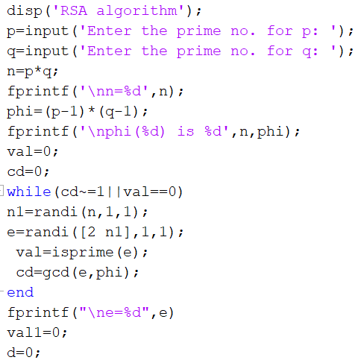
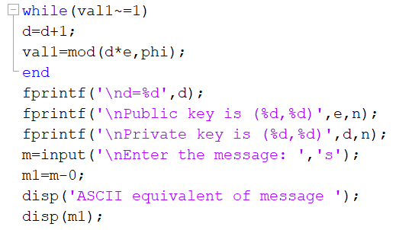
Go, change the world
RV College of
Engineering
RSA ALGORITHM

Slide 17
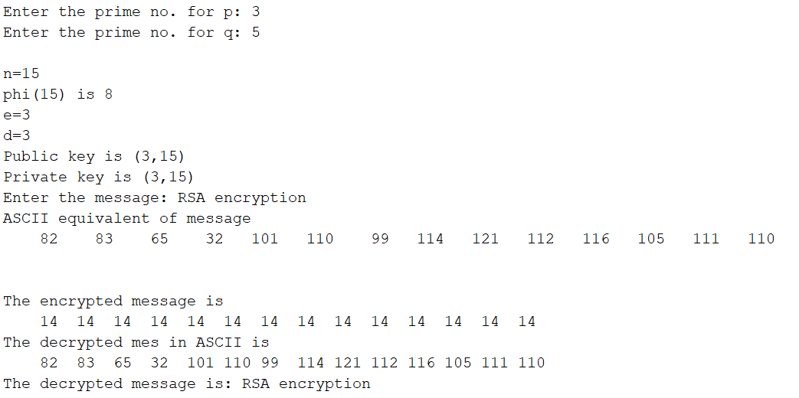
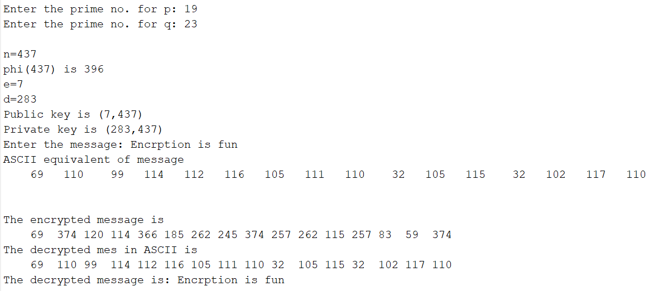
Go, change the world
RV College of
Engineering
RSA ALGORITHM

Slide 18
Go, change the world
RV College of
Engineering
GROUP THEORY
Group Theory is a branch of mathematics and abstract algebra that defines an algebraic structure named as group. Generally, a group comprises of a set of elements and an operation over any two elements on that set to form a third element also in that set.
A finite set S with the property ‘ο’ is called a semigroup if it holds the properties of closure and associativity.
A monoid is a semigroup with an identity element. The identity element (denoted by e or E) of a set S is an element such that (aοe)=a, for every element a∈S.
An identity element is also called a unit element. So, a monoid holds three properties simultaneously − Closure, Associative, Identity element.
A group is a monoid with an inverse element. The inverse element (denoted by I) of a set S is an element such that (aοI)=(Iοa)=a, for each element a∈S.
A group holds four properties simultaneously -
i) Closure
ii) Associative
iii) Identity element
iv) Inverse element

Slide 19
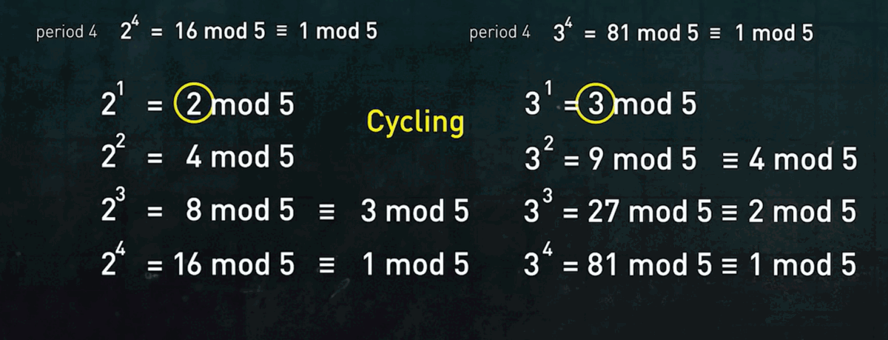
Go, change the world
RV College of
Engineering
CYCLIC GROUPS
A cyclic group is a group that can be generated by a single element. Every element of a cyclic group is a power of some specific element which is called a generator. A cyclic group can be generated by a generator ‘g’, such that every other element of the group can be written as a power of the generator ‘g’.

Slide 20
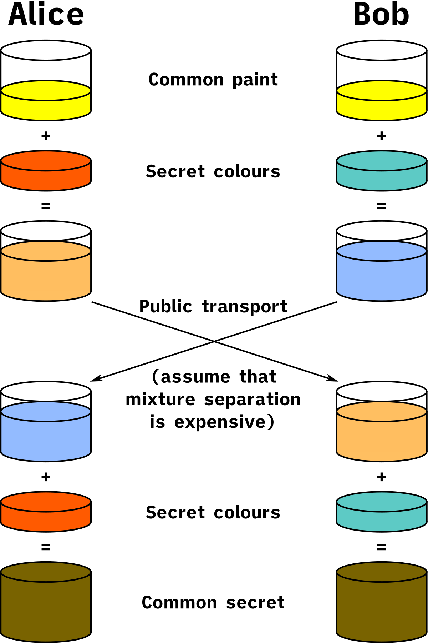
Go, change the world
RV College of
Engineering
DIFFIE-HELLMAN ALGORITHM
In this algorithm, both parties exchange messages that contribute to the computed shared secret
It involves creation of a function using the concepts of group theory and modular arithmetic such that f(f(x, a), b) = f(f(x, b), a). This equivalent value is the shared key.
This method is commonly used in TLS encryption to generate the shared key that can be used for symmetric encryption using AES.
It can be thought of easily in terms of mixing paint as shown here.

Slide 21
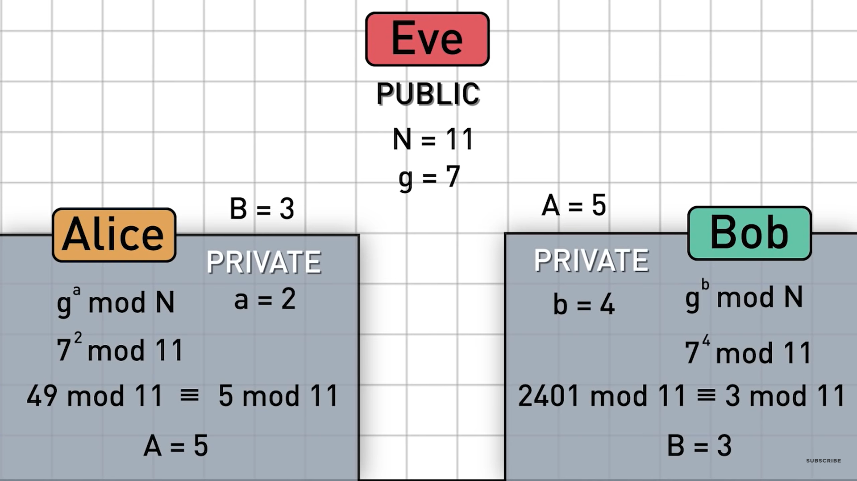
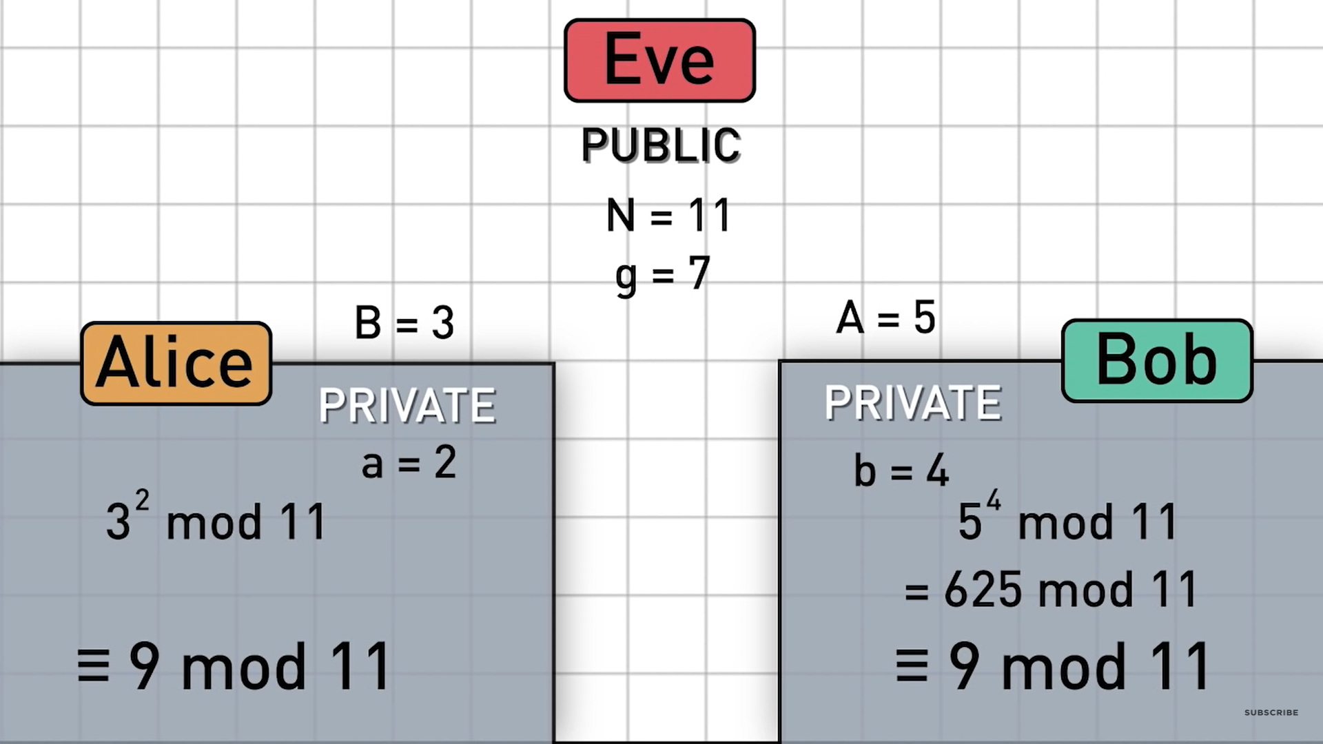
Go, change the world
RV College of
Engineering
DIFFIE-HELLMAN ALGORITHM
The algorithm in itself is very simple. Let’s assume that Alice wants to establish a shared secret with Bob and Eve is an external observer. Here’s an example of the protocol with secret values in red.
Alice and Bob agree to use a prime number N = 11 (chosen arbitrarily) and base g = 7. (g is one f the generators of the mod N group)
Alice chooses a secret integer a = 2, then sends it to Bob A = g^a mod N (A = 7^2 mod 11 = 5)
Bob chooses a secret integer b = 4, then sends it to Alice B = g^b mod N (B = 7^4 mod 11 = 3)
Alice computes s = B^a mod N (s = 3^2 mod 11 = 9)
Bob computes s = A^b mod N (s = 5^4 mod 11 = 9)
Alice and Bob now share a secret (the number 9).

Slide 22
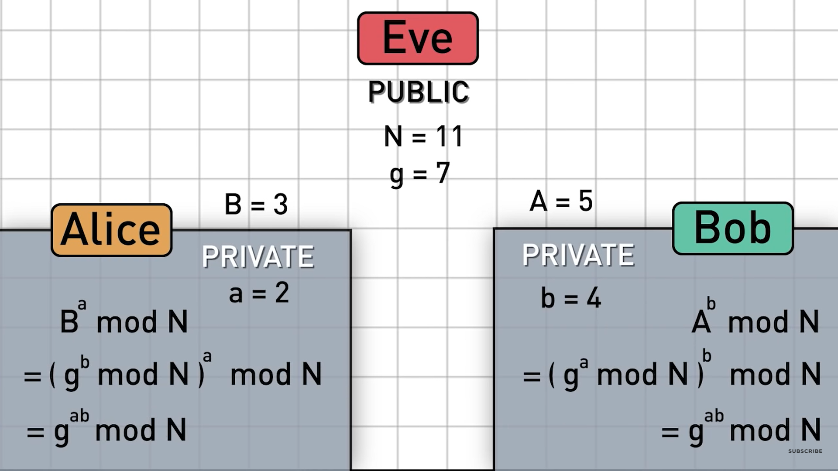
Go, change the world
RV College of
Engineering
DIFFIE-HELLMAN ALGORITHM
Here, we see the net operation performed is g^(ab) mod N for both Alice and Bob which is the shared key.
This works because exponent rules still hold in modular arithmetic.

Slide 23
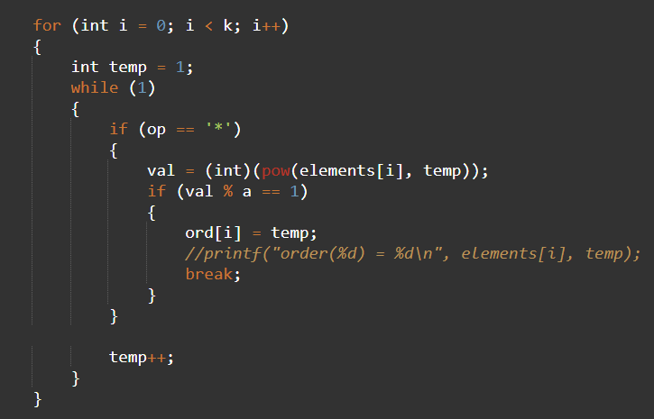
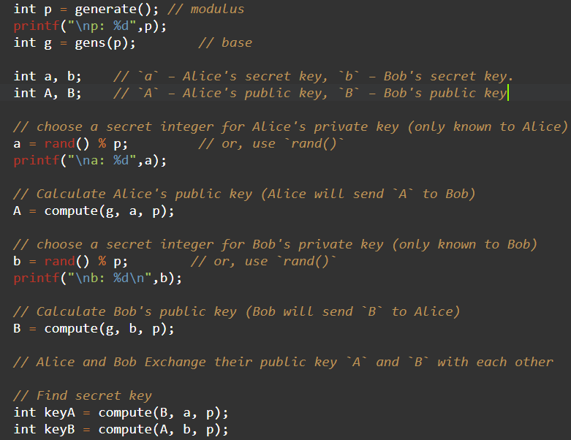
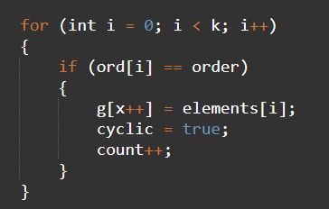
Go, change the world
RV College of
Engineering
DIFFIE-HELLMAN ALGORITHM

Slide 24
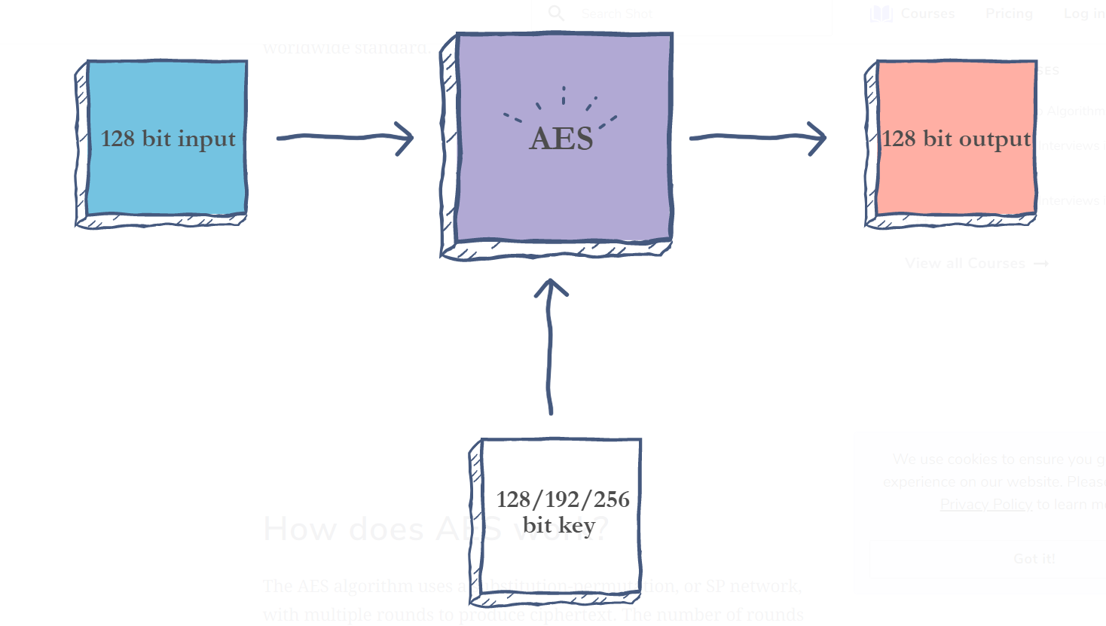
Go, change the world
RV College of
Engineering
AES ENCRYPTION
Also known as the Rijndael algorithm
Symmetric block cipher algorithm with a block/chunk size of 128 bits.
Converts these individual blocks using keys of 128, 192, and 256 bits. Once it encrypts these blocks, it joins them together to form the ciphertext.
Based on a substitution-permutation network, also known as an SP network. It consists of a series of linked operations, including replacing inputs with specific outputs (substitutions) and others involving bit shuffling (permutations).

Slide 25
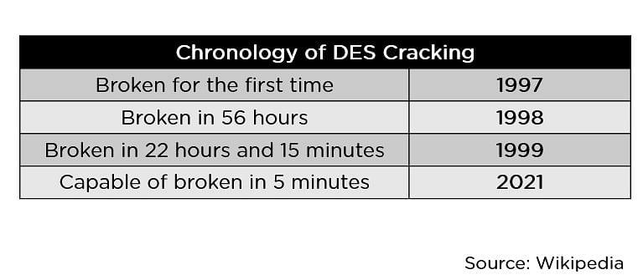
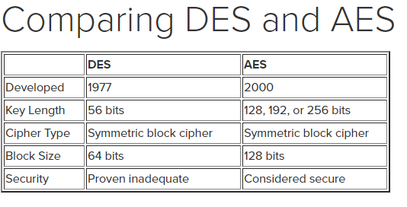
Go, change the world
RV College of
Engineering
WHY WAS AES ENCRYPTION NECESSARY?
Background
In the 1990s, DES was rendered insecure due to its relatively small 56-bit key size.
So, in 1997, the Advanced Encryption Standard (AES) was proposed in response to a public call for proposals by the National Institute of Standards and Technology (NIST).

Slide 26
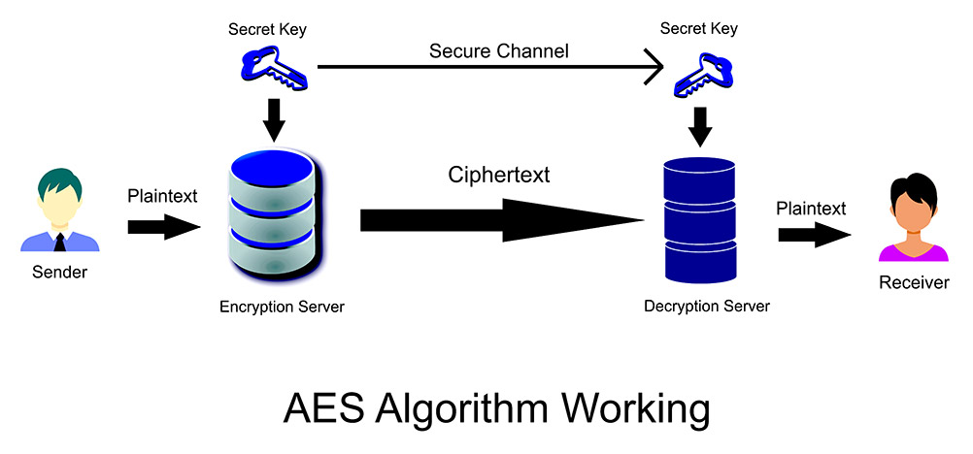
Go, change the world
RV College of
Engineering
FEATURES OF AES
SP Network: It works on an SP network structure rather than a Feistel cipher structure, as in the case of the DES algorithm.
Key Expansion:It takes a single key up during the first stage, which is later expanded to multiple keys used in individual rounds.
Byte Data: The AES encryption algorithm does operations on byte data instead of bit data. So it treats the 128-bit block size as 16 bytes during the encryption procedure.
Key Length: The number of rounds to be carried out depends on the length of the key being used to encrypt data. The 128-bit key size has ten rounds, the 192-bit key size has 12 rounds, and the 256-bit key size has 14 rounds.

Slide 27
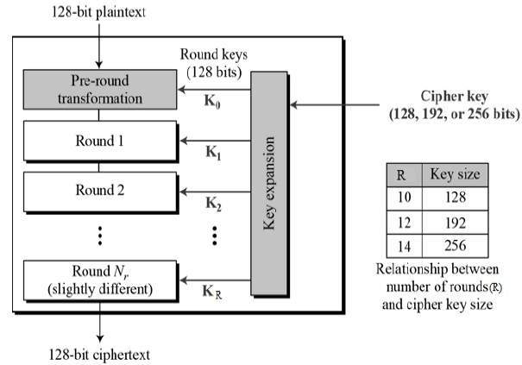
Go, change the world
RV College of
Engineering
HOW DOES AES WORK?
The AES algorithm uses a substitution-permutation, or SP network, with multiple rounds to produce ciphertext.
The number of rounds depends on the key size being used.
A 128-bit key size dictates ten rounds, a 192-bit key size dictates 12 rounds, and a 256-bit key size has 14 rounds.
Each of these rounds requires a round key, but since only one key is inputted into the algorithm, this key needs to be expanded to get keys for each round, including round 0.

Slide 28
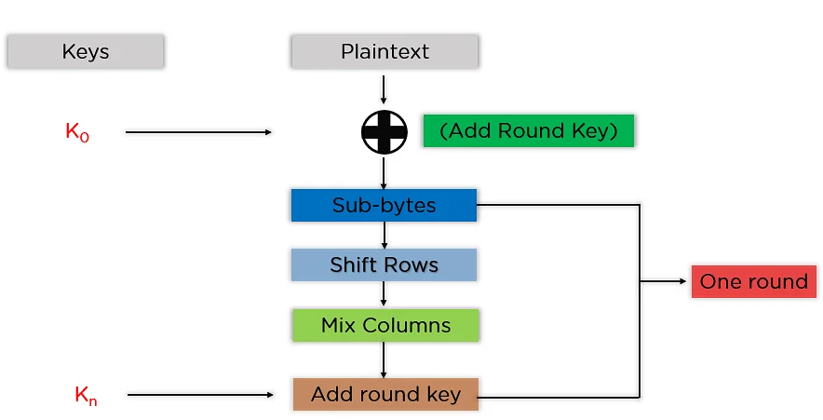
Go, change the world
RV College of
Engineering
HOW DOES AES WORK?
Steps to be followed in each round:

Slide 29
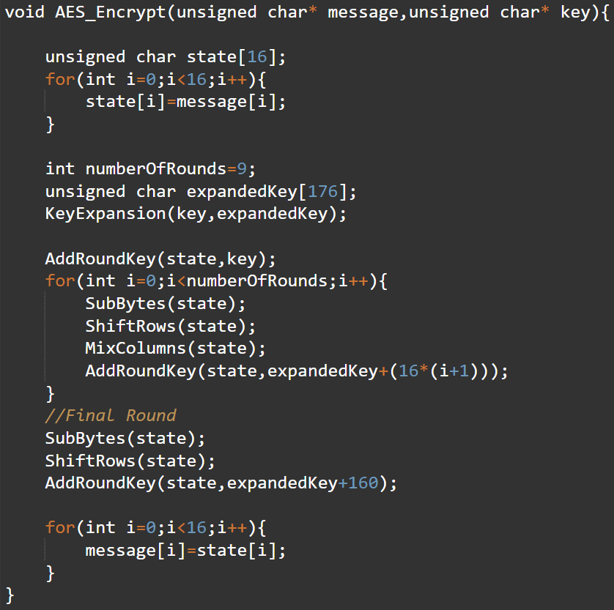
Go, change the world
RV College of
Engineering
HOW DOES AES WORK?

Slide 30
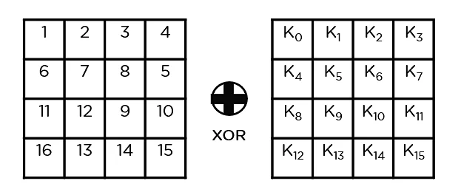
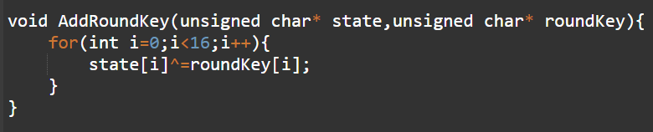
Go, change the world
RV College of
Engineering
HOW DOES AES WORK?
Steps to be followed in each round:
Add round key

Slide 31
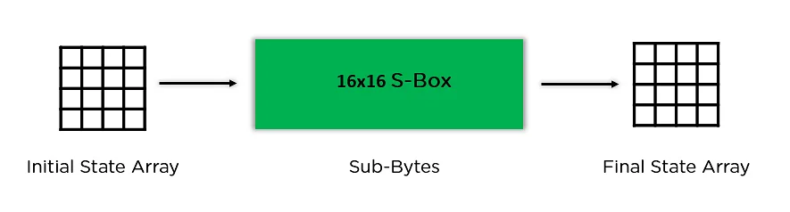
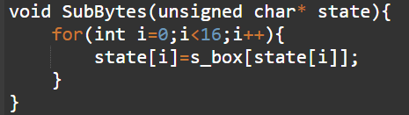
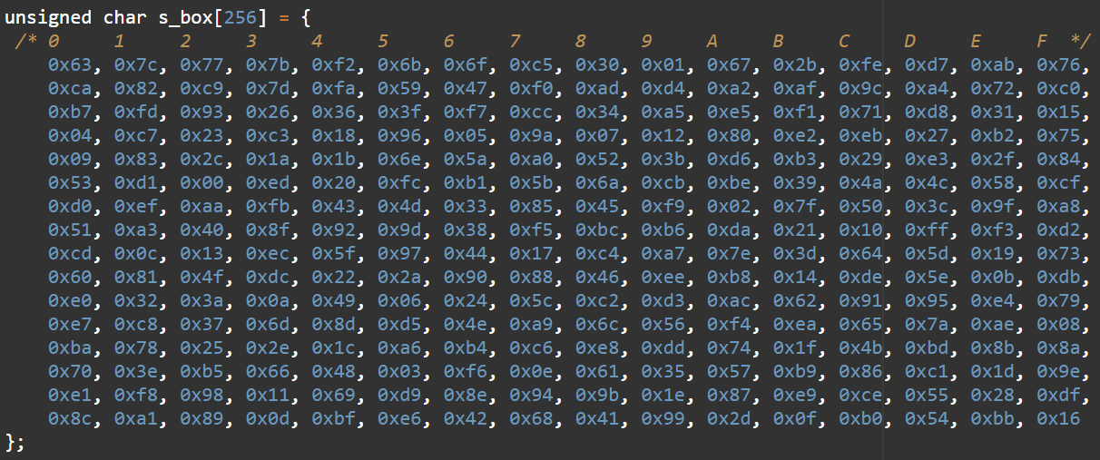
Go, change the world
RV College of
Engineering
HOW DOES AES WORK?
Sub-bytes

Slide 32
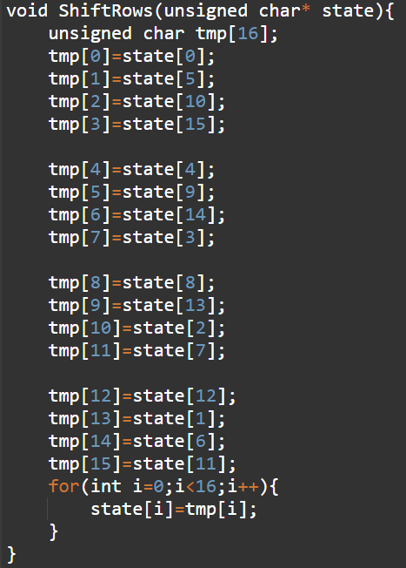
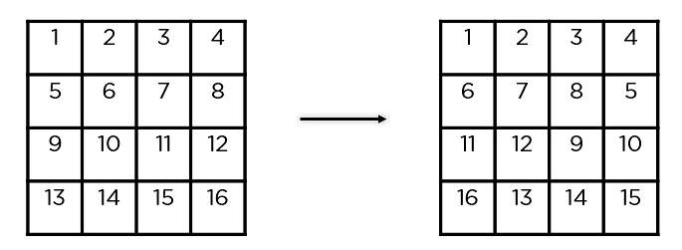
Go, change the world
RV College of
Engineering
HOW DOES AES WORK?
Shift Rows

Slide 33
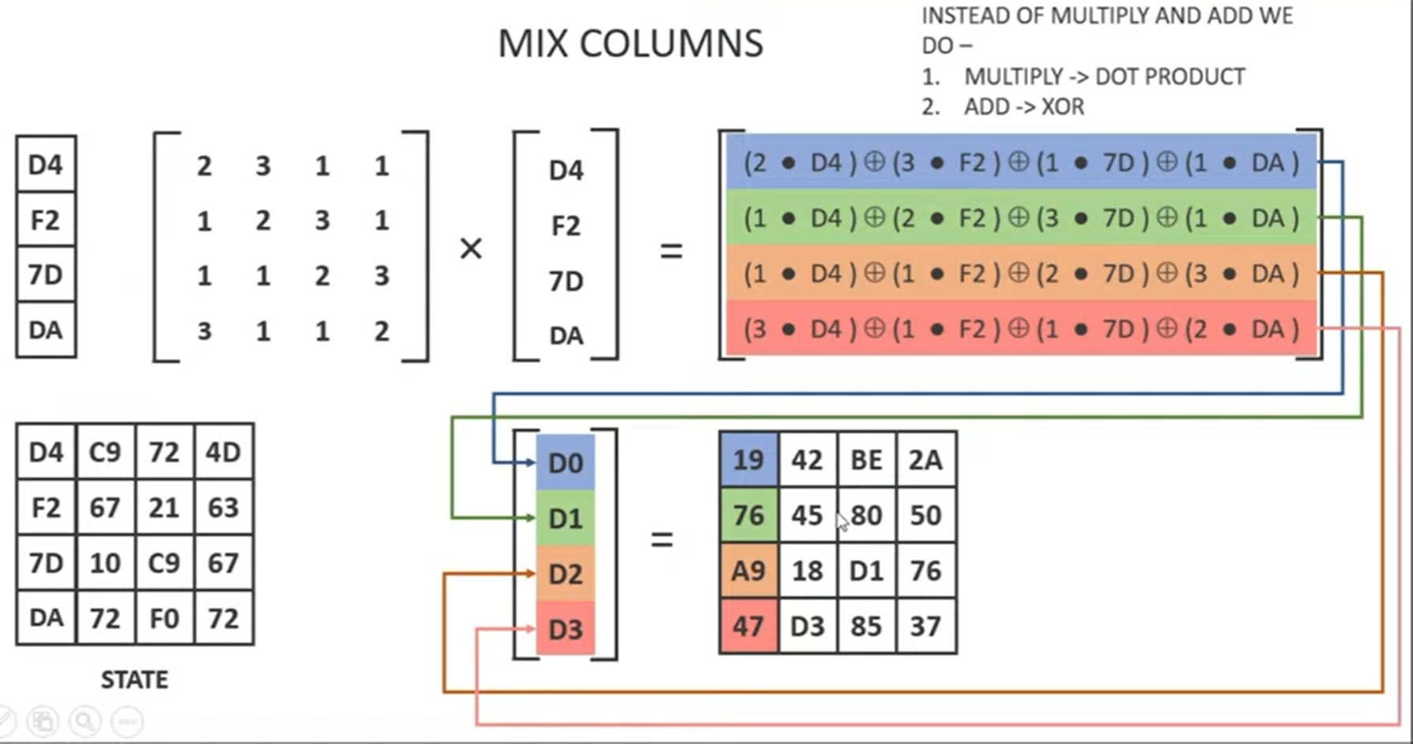
Go, change the world
RV College of
Engineering
HOW DOES AES WORK?

Slide 34
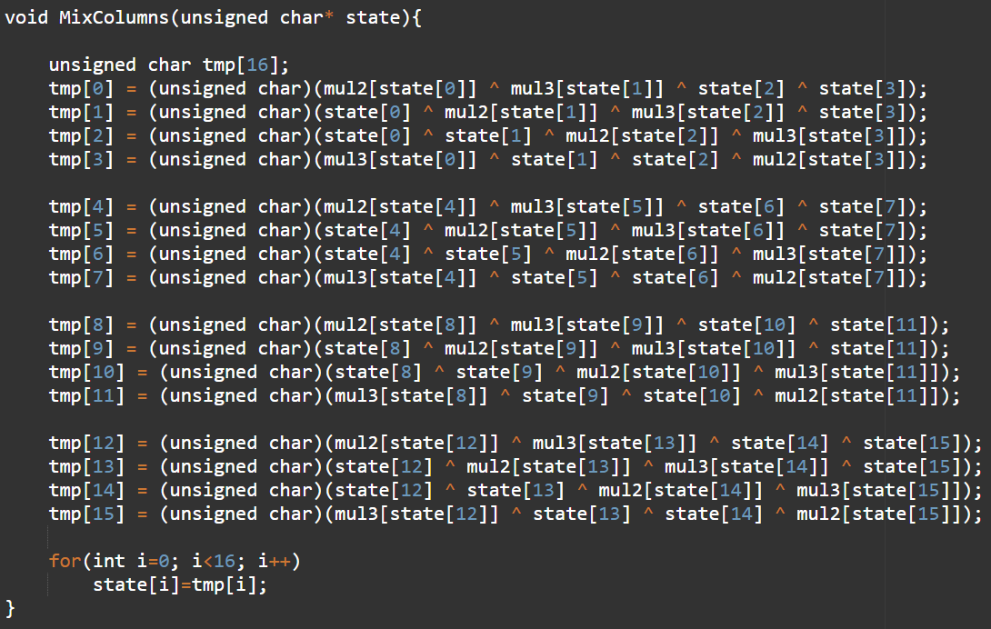
Go, change the world
RV College of
Engineering
HOW DOES AES WORK?

Slide 35
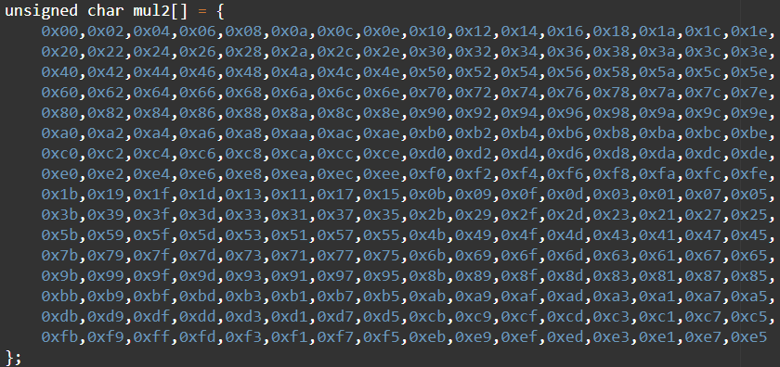
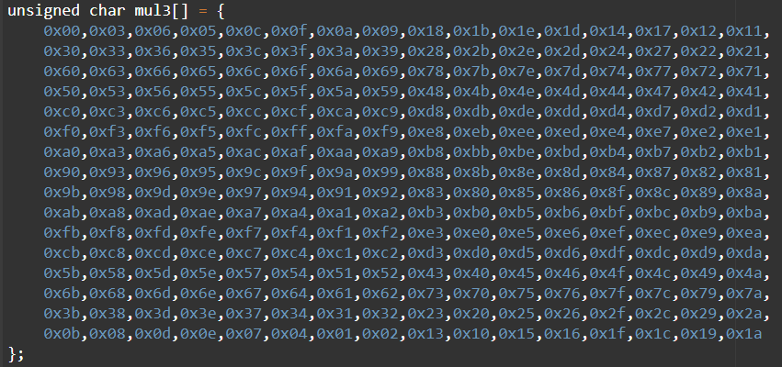
Go, change the world
RV College of
Engineering
HOW DOES AES WORK?

Slide 36
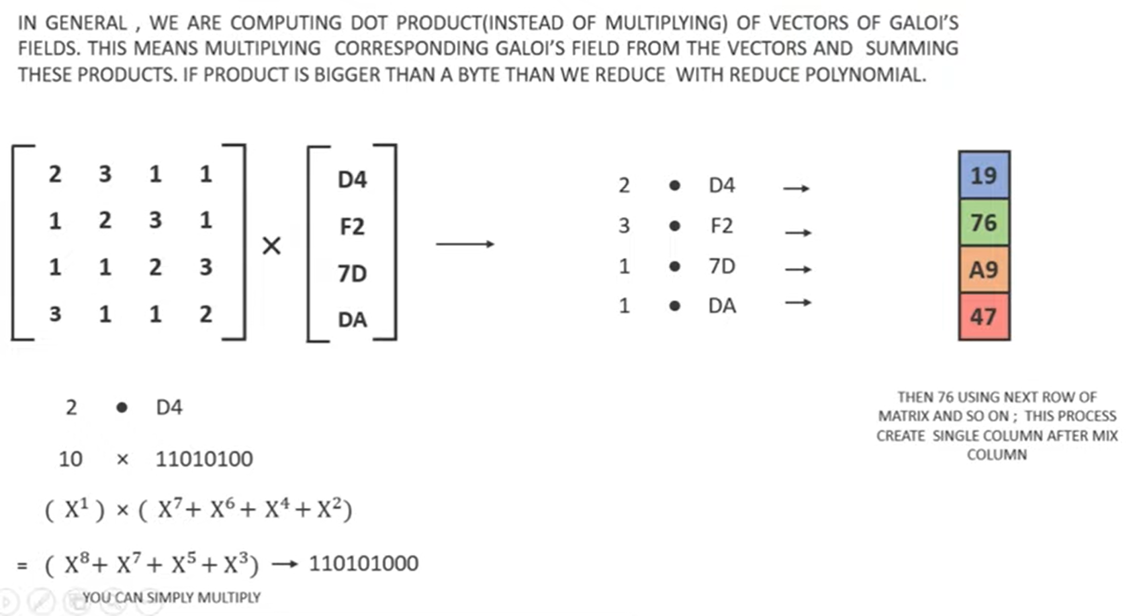
Go, change the world
RV College of
Engineering
HOW DOES AES WORK?

Slide 37
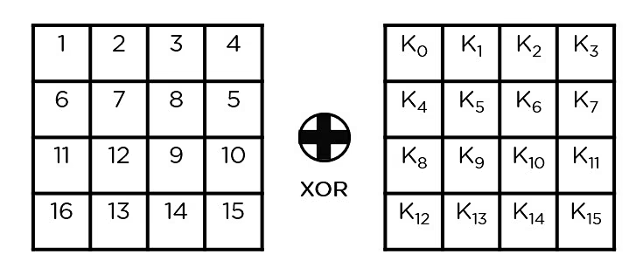
Go, change the world
RV College of
Engineering
HOW DOES AES WORK?
Add round key:

Slide 38
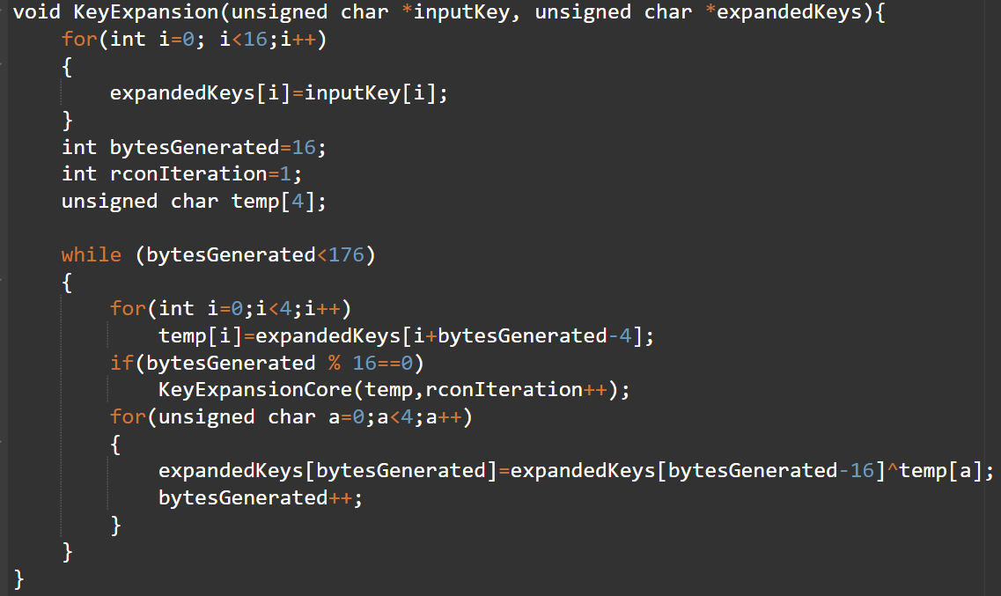
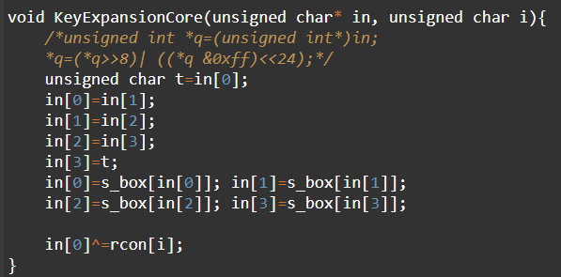
Go, change the world
RV College of
Engineering
HOW DOES AES WORK?
Key expansion

Slide 39
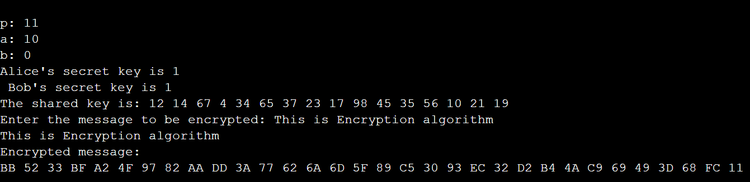
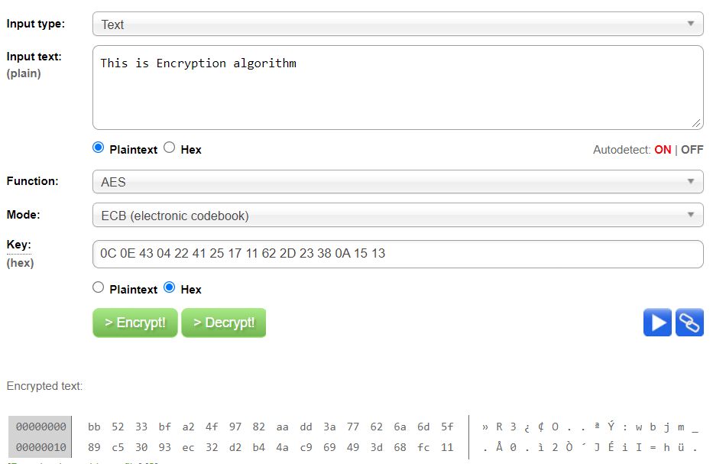
Go, change the world
RV College of
Engineering
OUTPUT

Slide 40


Go, change the world
RV College of
Engineering
OUTPUT

Slide 41

Go, change the world
RV College of
Engineering
OTHER APPLICATIONS

